Slide 1
Predicting Customer Attrition: A Comprehensive Machine Learning Approach
A Step-by-Step Analysis and Implementation
Group 5: Nathnael Seyoum, Yonatan Embiza

Slide 2
Content
Introduction
Dataset Description
Exploratory Data Analysis (EDA)
Data Preprocessing
Handling Class Imbalance
Baseline Model
Feature Engineering
Model Training And Evaluation
Model Comparison
Performance Corves
Advanced Techniques
Final Report and Documentation

Slide 3
Introduction
Project Overview: This project aims to predict customer attrition in a bank using various machine learning techniques.
Importance: Understanding and predicting customer churn helps in retaining valuable customers and planning effective retention strategies.
Objectives:
Develop a robust predictive model.
Handle class imbalance.
Compare various machine learning algorithms.

Slide 4
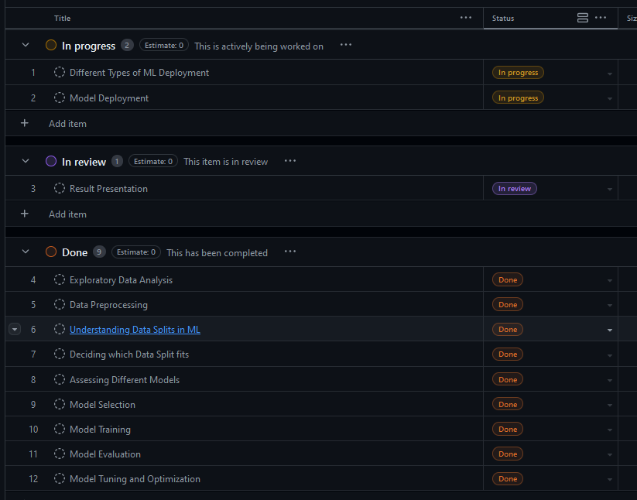
Collaboration and Development Environment
Google's colab for coding
Git for collaboration
Teams

Slide 5
Dataset Description
Source of the dataset: From Kaggle - Bank Customer Churn Data (https://www.kaggle.com/code/jessintha/credit-card-customer-churn-prediction)
Key Features:
Demographics: Customer Age, Gender, Marital Status, Education Level, Income Category.
Transaction History: Total Transaction Count, Total Transaction Amount.
Credit Card Information: Credit Limit, Balance, Utilization Ratio.
Target Variable: Attrition_Flag (whether a customer has churned or not).

Slide 6
Exploratory Data Analysis (EDA)
Initial Inspection:
Number of rows and columns.
Data types and null values.
Visualizations:
Histograms: Distribution of numerical features.
Count plots: Distribution of categorical features.
Findings:
Most customers are in the middle-income category.
Education level has a high percentage of 'Unknown'.
Visual Aids:
Bar charts showing distribution of categorical variables.
Histograms for numerical variables.

Slide 7
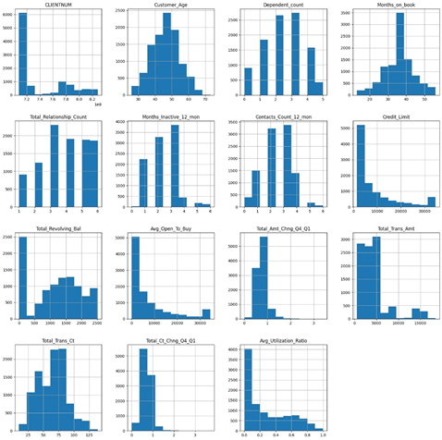
Before preprocessing

Slide 8
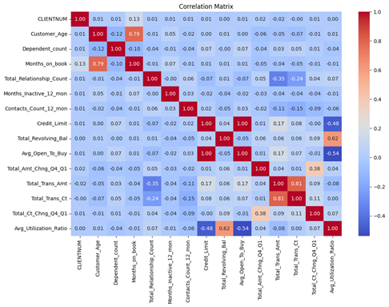

Slide 9
Data Preprocessing
Handling Missing Values:
Checked for NaN values and 'Unknown' categories.
Strategies to handle missing data.
Feature Encoding:
One-Hot Encoding: Gender, Marital Status.
Label Encoding: Education Level, Income Category, Card Category.
Outlier Detection:
Z-score method to identify outliers.
Treatment of outliers: Removal or adjustment.

Slide 10
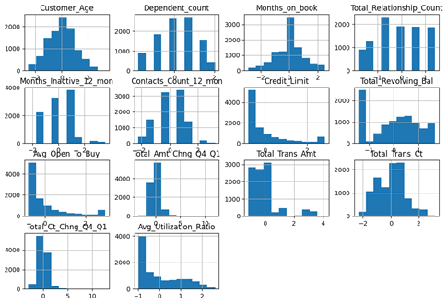
After preprocessing

Slide 11
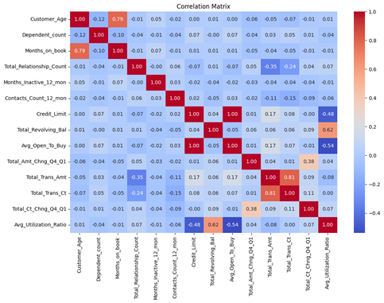

Slide 12
Handling Class Imbalance
Imbalance: Identified severe class imbalance in the target variable.
Techniques:
SMOTE (Synthetic Minority Over-sampling Technique).
Undersampling the majority class.
Adjusting class weights in models.

Slide 13
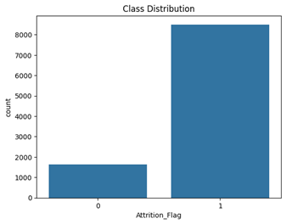
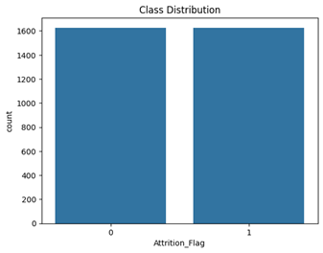
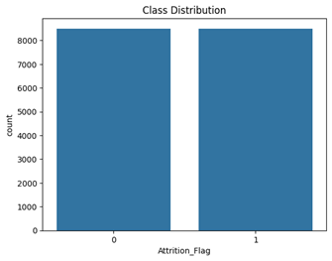

Slide 14
Baseline Model
Initial Model: Logistic Regression.
Purpose: Establish a benchmark for comparison.
Performance Metrics:
Training accuracy: 0.85.
Testing accuracy: 0.82.
Precision, Recall, F1-Score.
Performance metrics table.

Slide 15
Performance results
Baseline Model - Training Score: 0.85
Baseline Model - Testing Score: 0.82
Classification Report (Baseline Model):
precision recall f1-score support
0 0.73 0.50 0.59 325
1 0.91 0.96 0.94 1701
accuracy 0.85 2026
macro avg 0.82 0.73 0.76 2026
weighted avg 0.88 0.89 0.88 2026

Slide 16
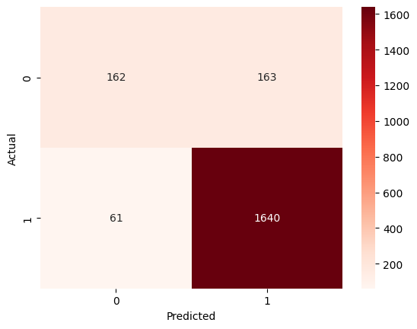
Confusion Matrix (Logistic Regression)

Slide 17
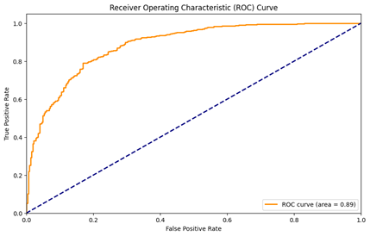

Slide 18
Feature Engineering
Correlation Analysis:
Heatmaps to visualize correlations.
Identified highly correlated pairs.
Feature Selection:
Removed features to reduce redundancy and multicollinearity.
Final set of features used for modeling.

Slide 19
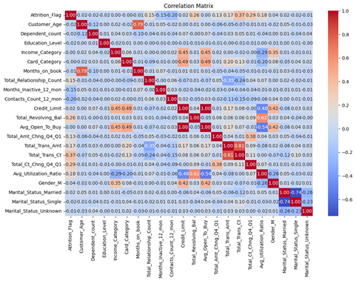

Slide 20
Correlation Result
Credit_Limit Avg_Open_To_Buy 0.995981 Total_Trans_Amt Total_Trans_Ct 0.807192 Customer_Age Months_on_book 0.788912 Marital_Status_Married Marital_Status_Single 0.741185 Total_Revolving_Bal Avg_Utilization_Ratio 0.624022 Avg_Open_To_Buy Avg_Utilization_Ratio 0.538808 Card_Category Credit_Limit 0.492446 Avg_Open_To_Buy 0.489985 Credit_Limit Avg_Utilization_Ratio 0.482965 Income_Category Credit_Limit 0.446349

Slide 21
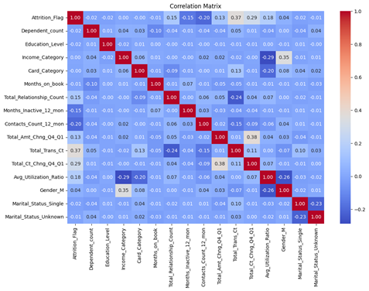

Slide 22
Model Training and Evaluation
Algorithms Used:
Logistic Regression, KNN, SVC, Decision Tree, Random Forest.
XGBoost, AdaBoost, Gradient Boosting, MLP, CatBoost, LightGBM.
Evaluation Metrics:
Accuracy, Precision, Recall, F1-Score.
ROC-AUC for model comparison.
Visual Aids:
ROC-AUC curve.
Performance metrics table.

Slide 23
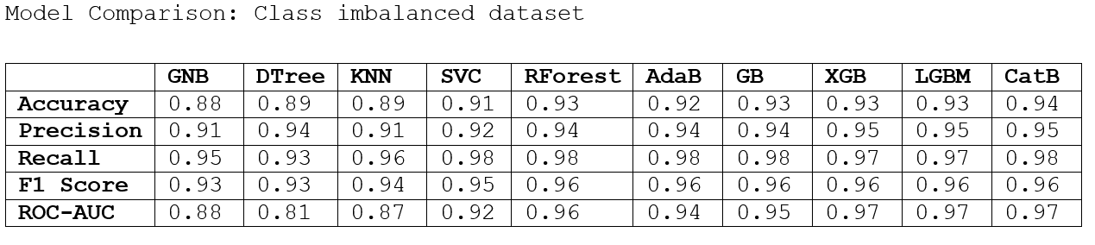

Slide 24
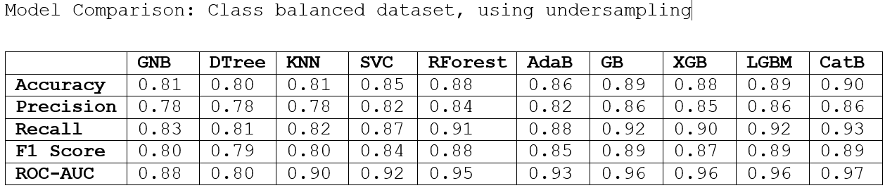

Slide 25
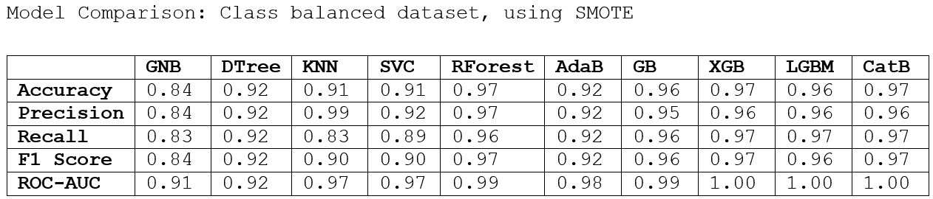

Slide 26
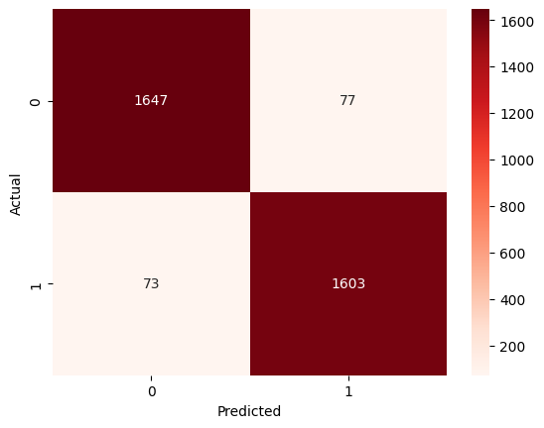
Confusion Matrix (Gradient Boosting)

Slide 27
Model Comparison
Performance Summary:
Table of metrics for each model.
Best performing models highlighted.
Visualizations:
ROC Curves: Comparison of all models.
Precision-Recall Curves: Additional insights.
Visual Aids:
ROC and Precision-Recall curves.

Slide 28
Ensemble Learning
Stacking Classifier:
Base models: Logistic Regression, Random Forest, XGBoost, etc.
Meta-Classifier: Logistic Regression.
Performance:
Improved accuracy and robustness.
Performance comparison before and after stacking

Slide 29
Performance Curves
Training vs. Testing Curves:
Visualize overfitting/underfitting.
ROC-AUC Curves:
Showcasing model performance.
Importance of ROC-AUC in model evaluation.
Training and testing accuracy plots.
ROC-AUC curves for all models.

Slide 30
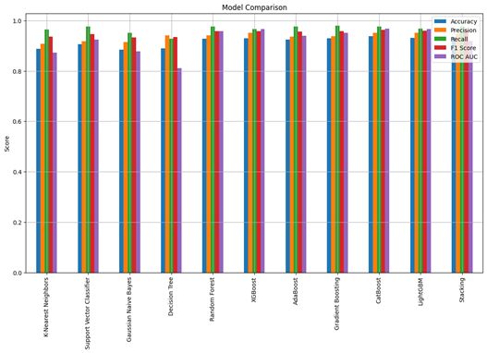
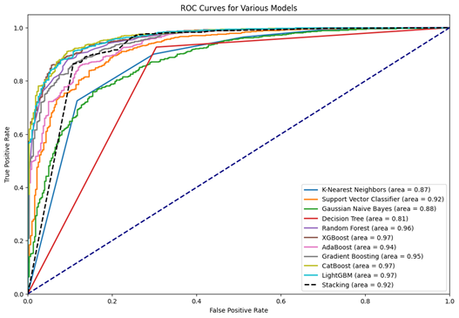

Slide 31
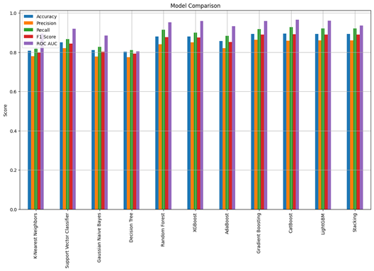
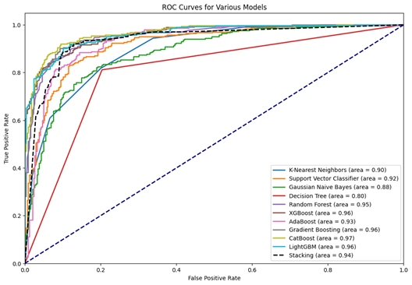

Slide 32
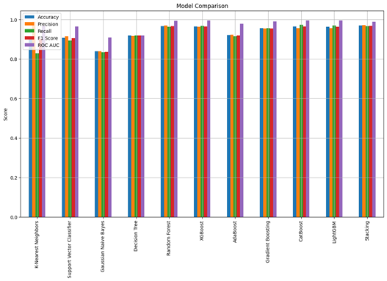
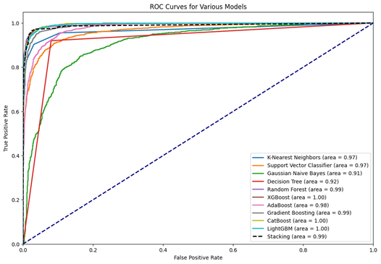

Slide 33
Advanced Techniques
Improvements:
Hyperparameter tuning: Grid Search, Random Search.
Advanced Ensembles: Bagging, Boosting.
Deep Learning: Neural networks for complex data patterns.
Data Augmentation:
Gathering more data: Surveys, additional sources.
Synthesizing new samples: Techniques like SMOTE.
Deep learning model architecture

Slide 34
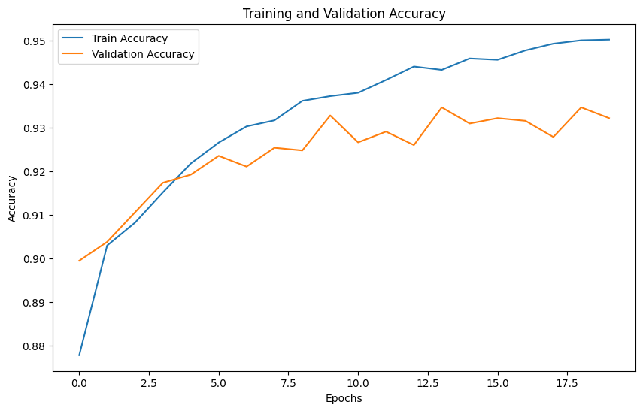

Slide 35
Final Report and Documentation
Documentation:
Detailed steps of the project.
Key findings and insights.
Importance of transparency and reproducibility.

Slide 36
Discussion Time :)

